Slide 1
Face Detection
Presented By
Gladson Rennis S - 231030
Bharath S – 231016
Boomeswar A - 231019
Cyril Liviyan L – 231020
Gokula Vadhana S-231031
Kavya S-231049

Slide 2
INTRODUCTION
Real time Face Detection using Open-CV
It’s numerous application over various fields,such as surveillance,biometrices and human - computer interaction.

Slide 3
OBJECTIVES
The objective of this project is to develop a real-time face detection system that can accurately detect and draw rectangles around faces in live video captured from a webcam.
Emphasize the importance of real-time face detection for applications like video surveillance, automatic attendance systems, and personalized user experiences.

Slide 4
Technologies Used
.Python
. Simplicity and versatility
.OpenCV
. Powerful computer vision library
. Comprehensive functionalities, including face detection

Slide 5
Work Flow
Importing the necessary libraries
Starting an infinite loop to continuously process video frames
Loading the pre-trained Haar cascade classifier for face detection
Initializing the video capture object to capture video from the default camera (index 0)
Converting the current video frame from BGR (Blue-Green-Red) color space to grayscale

Slide 6
Work Flow
Detecting faces in the grayscale frame using the function of the Haar cascade classifier
Iterating over the detected faces and drawing rectangles around them on the original frame
Waiting for a key press and checking if the 'q' key is pressed to break the loop and exit the program
Releasing the video capture object and destroying any remaining open windows:

Slide 7
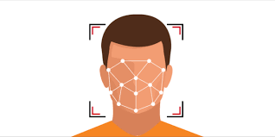
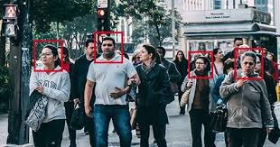
Results

Slide 8
Future Enhancements
Face Recognition
Emotion Recognition.

Slide 9
Thank You

